Slide 1
IP Addressing Summary

Slide 2
IPv4 Addressing
Networks recognize two addresses
Logical (Network layer)
Physical (MAC, hardware) addresses
IP protocol handles logical addressing
Specific parameters – IPv4
Unique 32-bit number
Divided into four octets (sets of eight bits)
Separated by periods
Example: 144.92.43.178

Slide 3
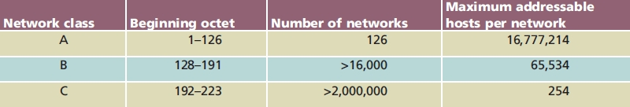
IPv4 Addressing (cont’d.)
Table 4-1 Commonly used TCP/IP classes
IP address information
Class A - Network address determined by first octet
Class B – Network address determined by first 2 octets
Class C – Network address determined by first 3 octets
In each case the octets unused for the network address determine the client address.

Slide 4
IPv4 Addressing (cont’d.)
Class D, Class E rarely used (never assign)
Class D: value between 224 and 230
Multicasting
Class E: value between 240 and 254
Experimental use
Eight bits have 256 combinations
Networks use 1 through 254
0: reserved as placeholder
10.0.0.0
255: reserved for broadcast transmission
10.0.0.255

Slide 5
IPv4 Addressing (cont’d.)
Class A devices
Share same first octet (bits 0-7) - Network ID
Host: second through fourth octets (bits 8-31)
Class B devices
Share same first two octet (bits 0-15) - Network ID
Host: third and fourth octets (bits 16-31)
Class C devices
Share same first three octet (bits 0-23) - Network ID
Host: fourth octet (bits 24-31)

Slide 6
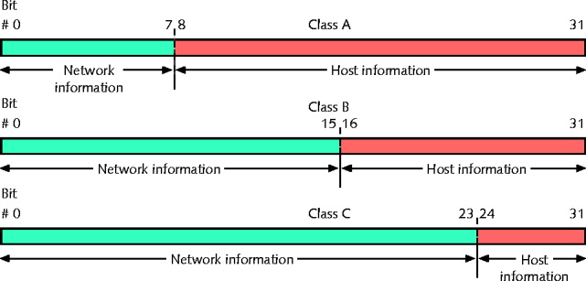
Figure 4-8 IP addresses and their classes

Slide 7
IPv4 Addressing (cont’d.)
Loop back address
First octet equals 127 (127.0.0.1)
Loopback test
Attempting to connect to own machine
Powerful troubleshooting tool
Indicates that your NIC and networking software is working
Windows
ipconfig command
For more information use ipconfig /all
Unix, Linux
ifconfig command
May have to be installed first

Slide 8
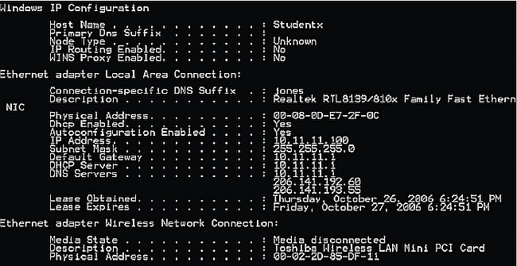
IPv4 Addressing (cont’d.)
Figure 4-9 Results of the ipconfig /all command on a Windows workstation. Physical address is the MAC address of the adapter.

Slide 9
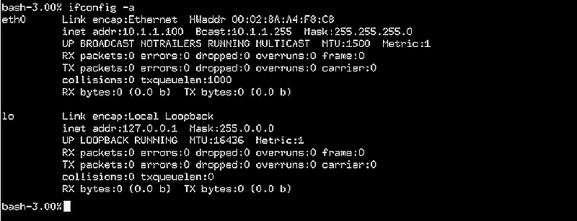
IPv4 Addressing (cont’d.)
Figure 4-10 Results of the ifconfig -a command on a UNIX workstation. Hwaddr is the MAC address of the network adapter

Slide 10
Binary and Dotted Decimal Notation
Decimal number between 0 and 255 represents each binary octet
Period (dot) separates each decimal
Dotted decimal address has binary equivalent
Converting each octet
Remove decimal points

Slide 11
Subnet Mask
Identifies every device on TCP/IP-based network
32-bit number (net mask)
Identifies device’s subnet
Combines with device IP address
Informs network about segment, network where device attached
Four octets (32 bits)
Expressed in binary or dotted decimal notation
Assigned same way a IP addresses
Manually, automatically (via DHCP)

Slide 12
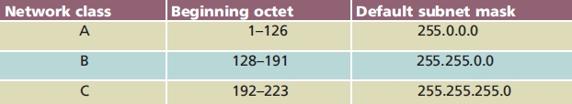
Table 4-2 Default subnet masks
For a given default subnet mask you must adhere to the beginning octet range for that network.
i.e. Class A networks must start with a value between 1-126, B between 128 – 191 and C between 192-223.

Slide 13
Automatic Private IP Addressing
A feature of Microsoft Windows, APIPA is a DHCP failover mechanism for local networks. With APIPA, DHCP clients can obtain IP addresses when DHCP servers are non-functional. APIPA exists in all modern versions of Windows except Windows NT.
When a DHCP server fails, APIPA allocates IP addresses in the private range 169.254.0.1 to 169.254.255.254.
In APIPA, all devices reside on the same Class B subnet.

Slide 14
APIPA (cont’d.)
APIPA
Assigns computer’s network adapter IP address from the pool
Assigns subnet default Class B network
255.255.0.0
Part of operating system
No need to register; check with central authority
Disadvantage
Computer only communicates with other nodes using addresses in APIPA range

Slide 15
APIPA (cont’d.)
APIPA suitable use
Small networks: no DHCP servers
APIPA unsuitable use
Networks communicating with other subnets, WAN
APIPA enabled by default
First checks for DHCP server
Allows DHCP server to assign addresses
Does not reassign new address if static
Can be disabled in registry

Slide 16
Automatic Private IP Addressing
This can sometimes be a valuable tool when debugging network configuration problems.
If you have a Windows automatic IP address instead of the address you expect from your DHCP server then you are having a connection problem back to the network’s DHCP server.
This can be caused by many things, but the first thing to check is all the cabling back from the Host to the server to see if there are any problems.
Also check to make sure that your computer is set to receive automatic IP addresses and is not manually setting the IP address to a range outside your server’s subnet.

Slide 17
Assigning IP Addresses
Routers and servers can give IP addresses to their hosts.
Switches, hubs and crossover cables cannot.
If you are connected only by a switch, hub or crossover cable then you should expect a windows automatic IP address.
If you are connected to a router or server then you should expect the IP address as dictated in the admin panel of the router or server.
We will look at this admin panel in the next lab.

Slide 18
Assigning IP Addresses (cont’d.)
Static IP address
Assignment manually
Modify client workstation TCP/IP properties
Only way to change
Human error cause duplicates
Automatic IP addressing
BOOTP and DHCP
Reduce duplication error

Slide 19
DHCP Leasing
Device borrows (leases) IP address
Devices use IP address temporarily
Specified time limit
Lease time
Determined when client obtains IP address at log on
User may force lease termination

Slide 20
PING (Packet Internet Groper)
Provides verification
TCP/IP installed, bound to NIC, configured correctly, communicating with network
Host responding
Uses ICMP services
Send echo request and echo reply messages
Determine IP address validity
Ping IP address or host name
Ping loopback address: 127.0.0.1
Determine if workstation’s TCP/IP services running

Slide 21
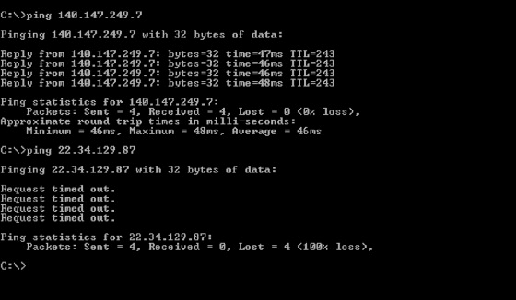
PING (cont’d.)
Figure 4-17 Output from successful and unsuccessful PING tests
Operating system determines Ping command options, switches, syntax

